Slide 1

Mobile design mobile programming and multimedia M.Sc. in Computer Science 2023/2024 Michael Amista’ (2122865) Sebastiano Sanson (2130917)

Slide 2
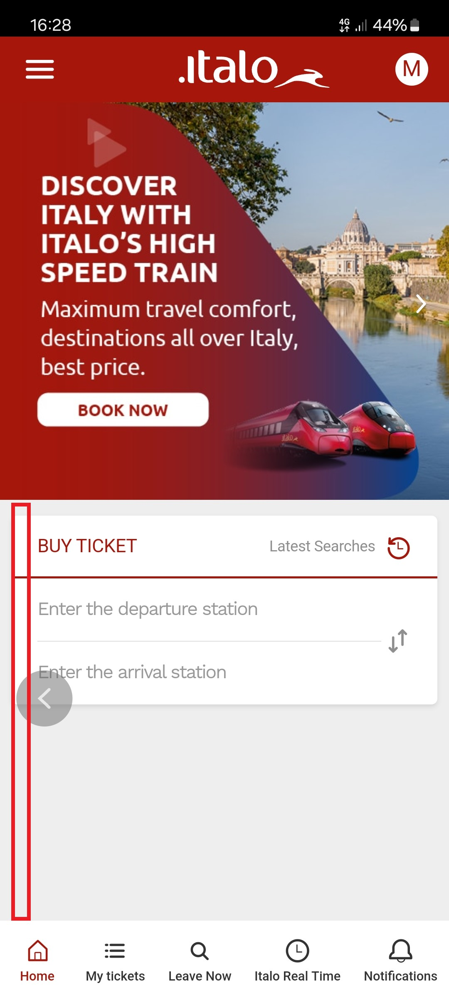
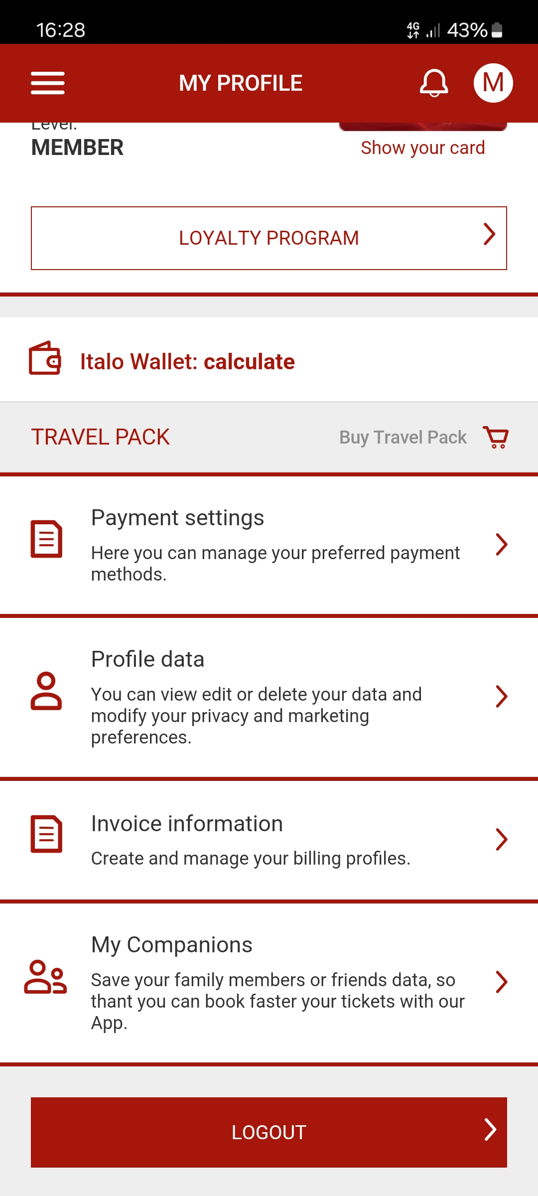
NEGATIVE DESIGN: ITALO
Main problems:
carousel management
conflict with OS gestures
loss of the bottom menu in internal pages
dangerous operations in the comfort zone
Some solutions:
use buttons to provide carousel information
delete problematic gestures
include the bottom menu across all pages
move dangerous operations outside the comfort zone

Slide 3
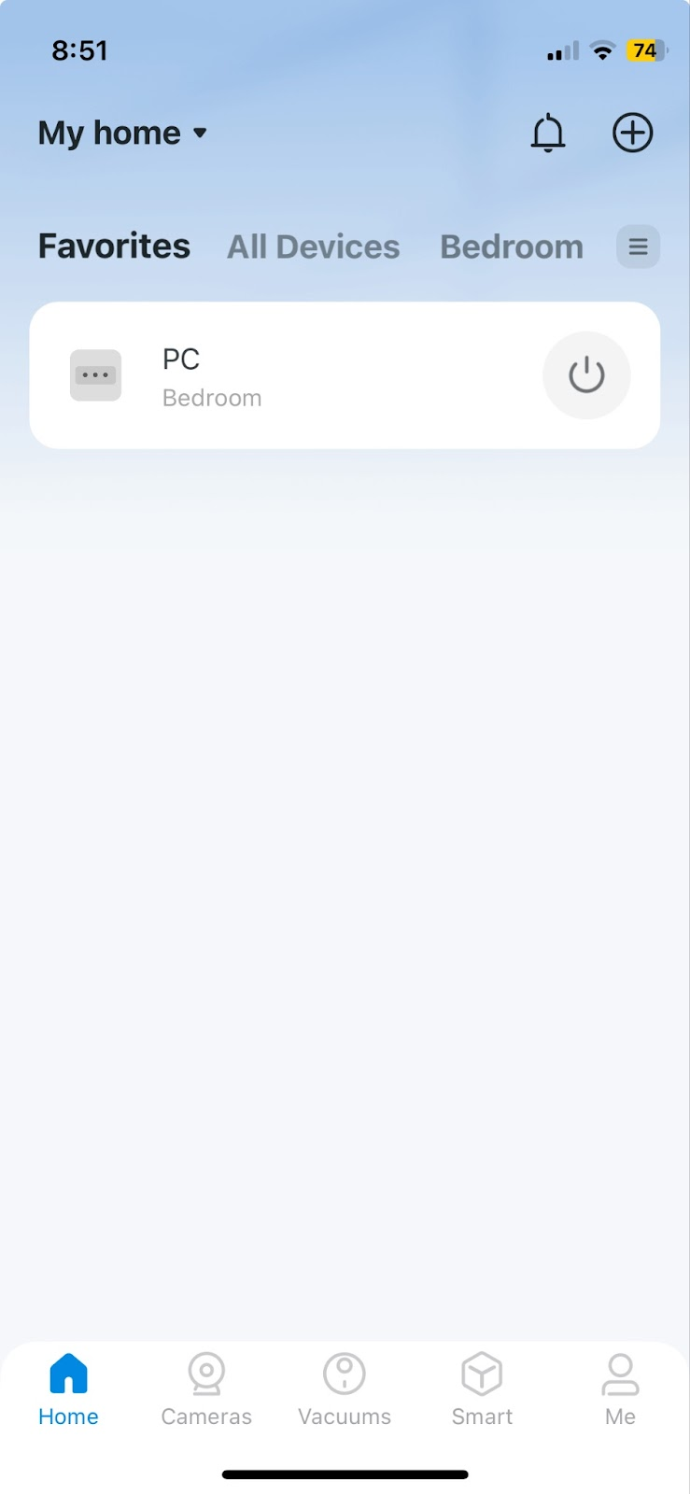
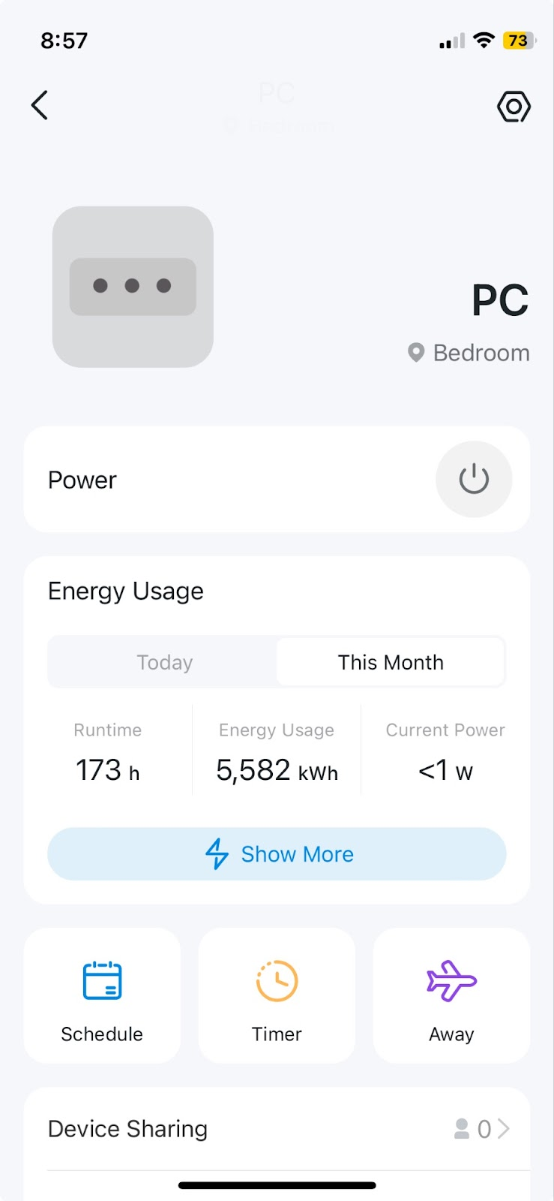
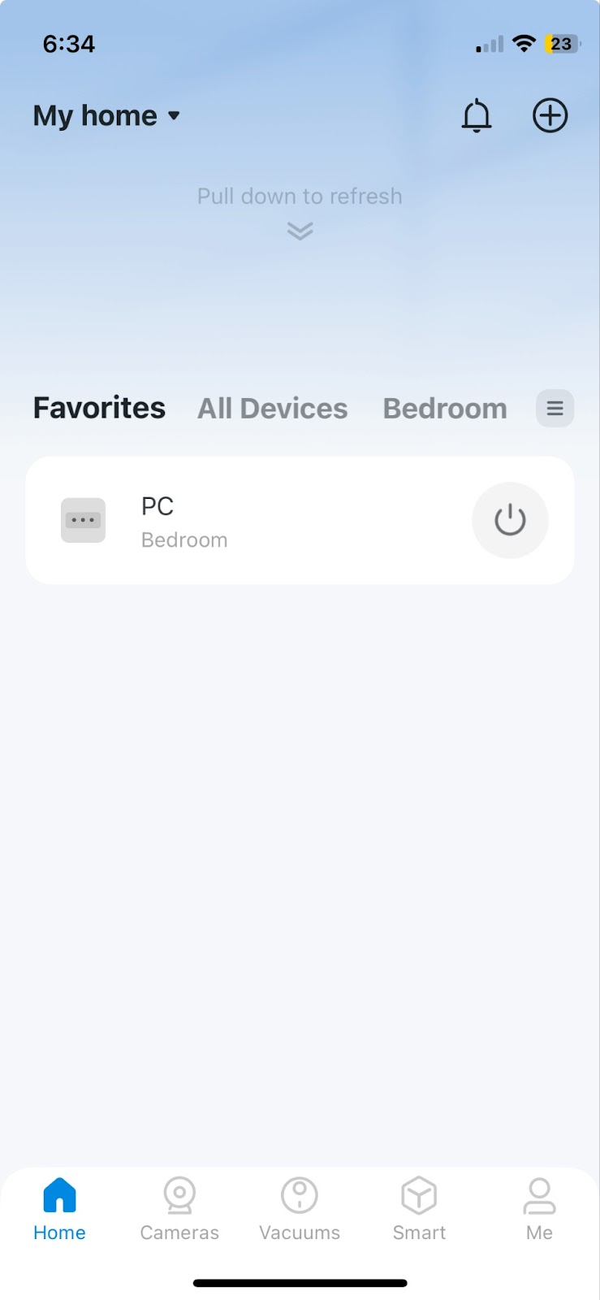
POSITIVE DESIGN: TAPO
Positive aspects:
Follows the principle: “content on top”
Just-in-time interfaces
Gestures

